Slide 1
Week 8 Updates: SolidWorks DFM Plug-In
Ruoyu Song
Dr. Cassandra Telenko
Aniruddh Marellapudi

Slide 2
Updates from Week 8
Added more SculptPrint automation
Finished design of researcher feedback UI
Researcher can use paint-like interface to highlight manufacturing issues
Produces a screenshot that is then imported into the SolidWorks plug-in

Slide 3
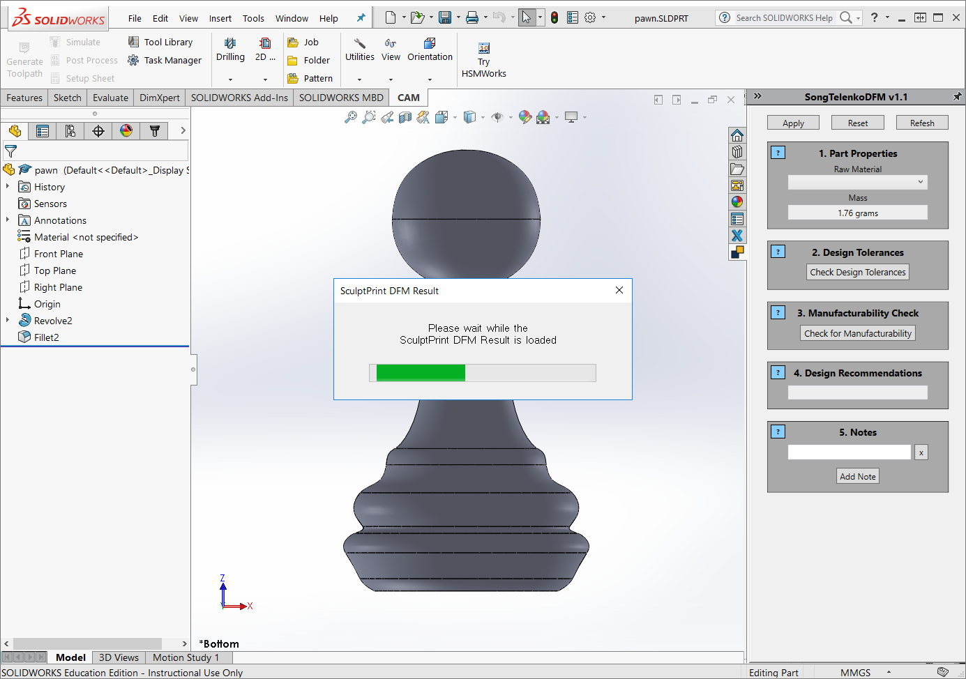

Slide 4
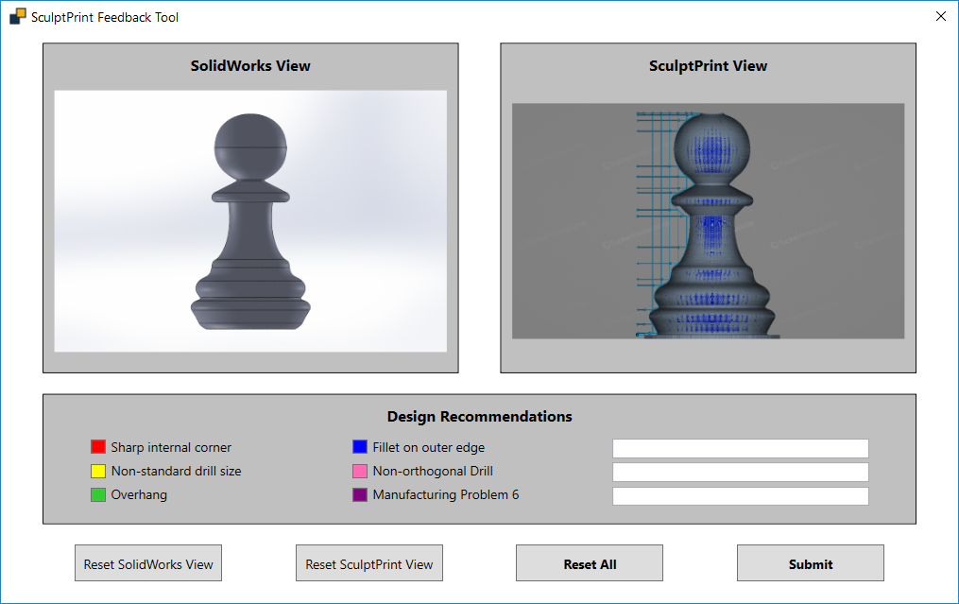

Slide 5
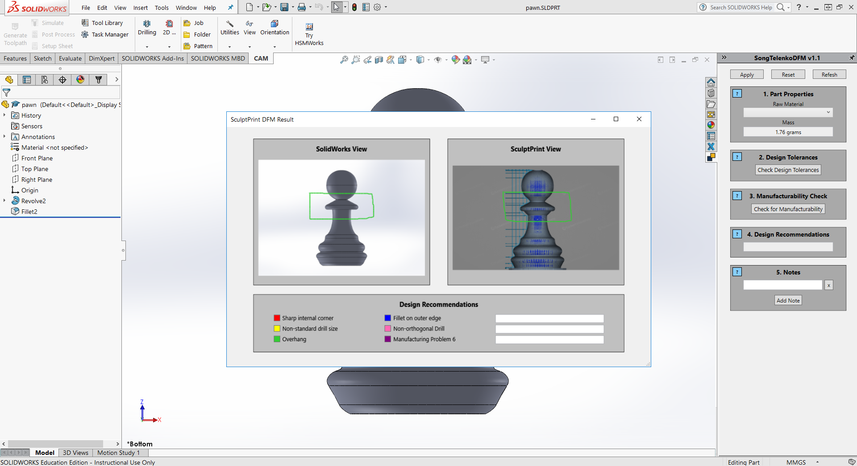

Slide 6
Work Flow for Design Feedback Experiment
User examines sample part (pawn)
User clicks “Check for Manufacturing”
User receives SculptPrint view with research feedback
Experiment Laptop
(ME Tag: 02279)
SculptPrint automation script is run on VM
Researcher provides feedback through custom app
Researcher
Machine

Slide 7
Experiment Laptop
(ME Tag: 02279)
Researcher Machine
Researcher Feedback app
Produces DFM feedback result (png)
Citrix Receiver logged into ME-VXL-M60
Runs automated SculptPrint script
SolidWorks window running Ruoyu’s experiment
SSH/SFTP

Slide 8
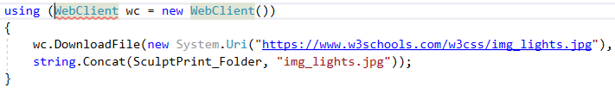
If SSH/SFTP does not pan out
We can use a website to host experiment files
I can test this on my web space (marellapudi.com)
Upload/download files between experiment laptop and research machine
Doesn’t require GT supervision (I think)

Slide 9
Next Steps
Finish SculptPrint interface
Finalize communication between experiment laptop and researcher machine
Conduct test run of experiment work flow to determine bugs
Make installation report and comment all code
This will be a word write-up
Make guide for tutorial part (pawn piece)

Slide 10
Project Decisions
Need a proper name and description to display in SolidWorks
Need to determine ideal instructions for message-box prompts
Need to choose message prompts when user hovers over info buttons

Slide 11
Problems List and Solution
AngelSix Add-In Installer returns with an error
The add-in installer runs RegAsm.exe to register your plug-in’s .dll
Can debug manually
cd C:\Windows\Microsoft.NET\Framework64\v4.0.30319
RegAsm.exe /codebase "C:\Users\Aniruddh\Desktop\solidworks-api-develop\Tutorials\DynamicReload\DynamicReload\bin\Debug\DynamicReload.dll"

Slide 12
Problems List and Solution (Cont’d)
Packages downloaded from GitHub do not compile because Dna.Framework is not a valid namespace
Dna.Framework, also written by AngelSix, is a NuGet package
NuGet is a free, open-source package manager in Visual Studio
Make sure this package is properly installed (with dependencies) for each solution

Slide 13
Problems List and Solution (Cont’d)
Make sure SolidWorks Interop files (SolidWorks Native API) have the same version as those referenced by AngelSix API
AngelSix API uses .NET Framework 4.7.1, so make sure this is consistent with your solution

Slide 14
Problems List and Solution (Cont’d)
Installing add-in shows too many Command Manager Items
Renaming the project when you have a Command Manager Item plug-in causes this
Have not found the fix so far
Possible walk-around: clone the project, and export a new .dll

Slide 15
Problems List and Solution (Cont’d)
SculptPrint Best Practices
Orient part with respect to the standard origin in CAD (SolidWorks)
Then when exporting as .STL, click options, and check “Do not translate STL output data to positive space”
Fixturing the part in SculptPrint now becomes very easy, as the coordinates defined in CAD should exactly transfer over to SculptPrint

Slide 16
Problems List and Solution (Cont’d)
NuGet SolidDna package was installed but the blue NuGet package icon is not showing up under project references
Try reinstalling, then close Visual Studio, then open Visual Studio

